Slide 1





INVEX
Warehouse Management System
Mobile Application
Database Project
Supervised by
DR/ Hend

Slide 2


Team Leader
Project DETAILS
Ahmed Mahmoud
BACKEND
node js & express
Team Members
Ahmed Moataz
FRONTEND
KOTLIN
Hassan Mohamed
DATABASE
SQL SERVER
Ahmed Elkholy
BACKEND
node js & express

Slide 3
content
1.
Introduction
2.
Database EER Diagram
3.
Database Mapping
4.
Backend Server Configuration
5.
Backend Warehouse Details Query
6.
Backend Deal Details Query
7.
Frontend Log In Screen
8.
Frontend Add New Company Screen
9.
Frontend Add New Deal Screen

Slide 4

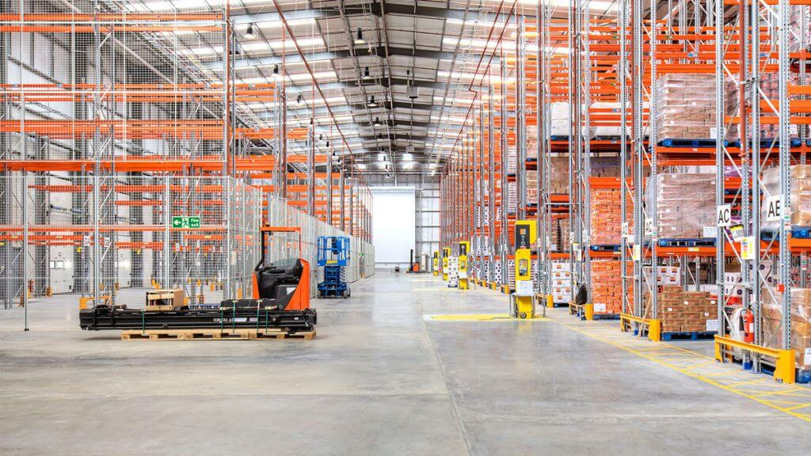




Introduction
What is INVEX?
Invex is a smart inventory and supply-chain management system designed to streamline the flow of products between suppliers, vendors, warehouses, and companies. It provides a centralized platform for managing deals, monitoring warehouse activity, organizing categories and items, and ensuring smooth communication between all parties involved in the supply process

Slide 5

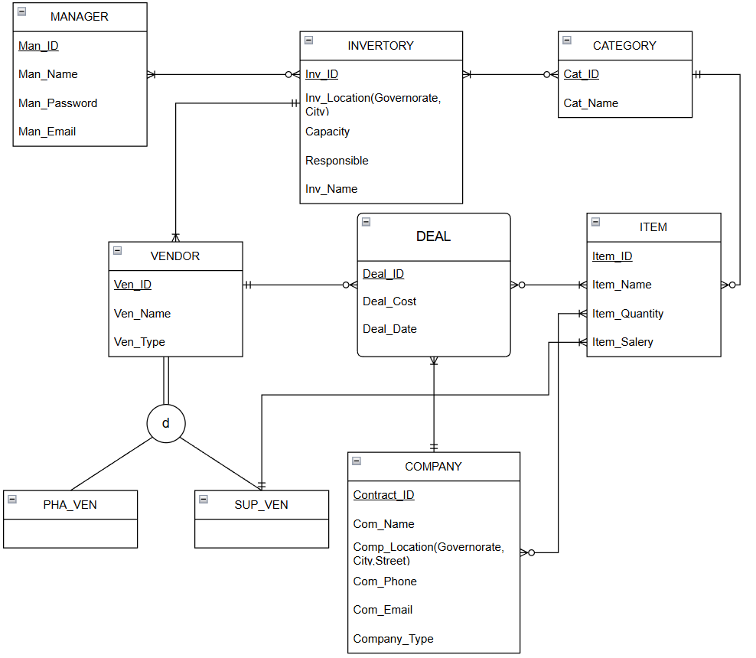

Database
EER Diagram Of Invex Database

Slide 6
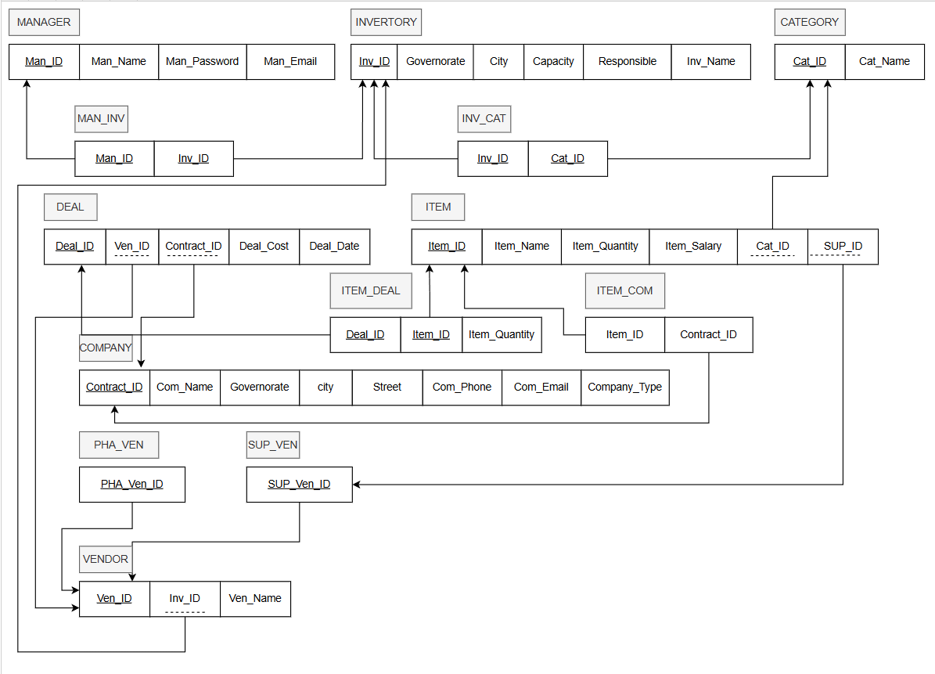
Database
Mapping & 3NF Of Invex Database

Slide 7
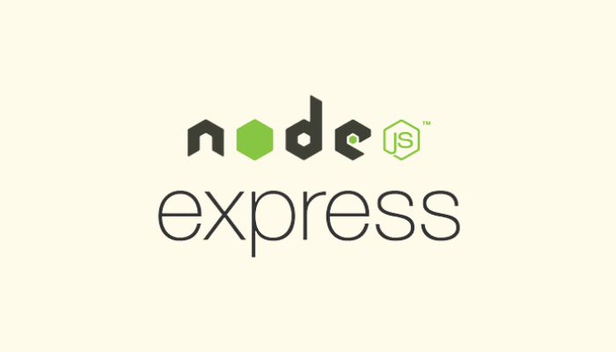
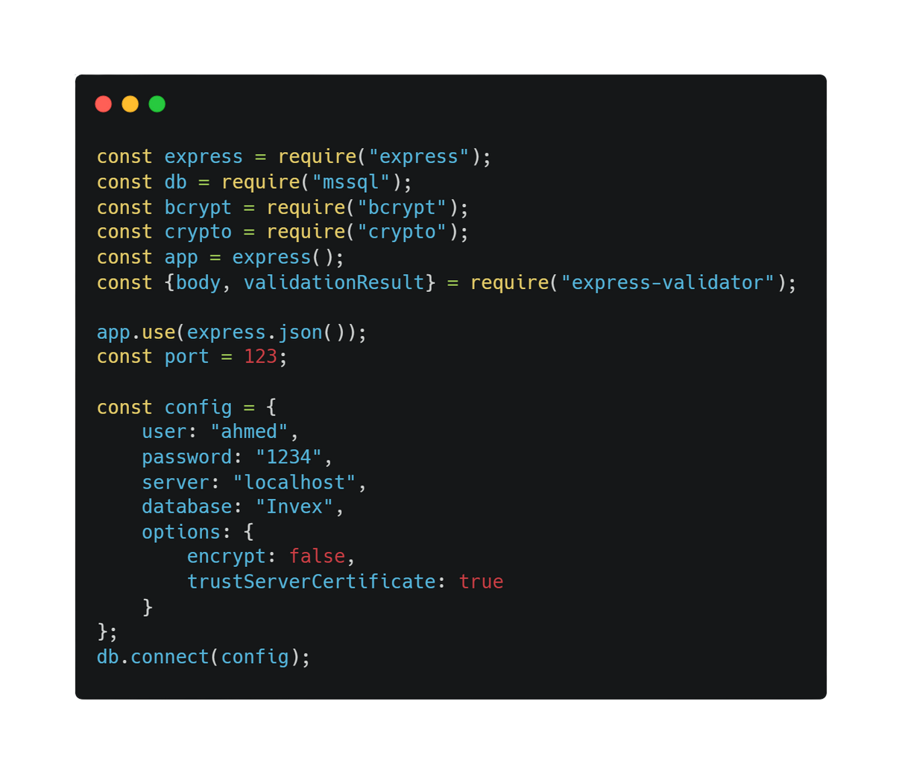
Backend
Node Js &Express
Backend Server Configuration (Node.js + MSSQL)

Slide 8
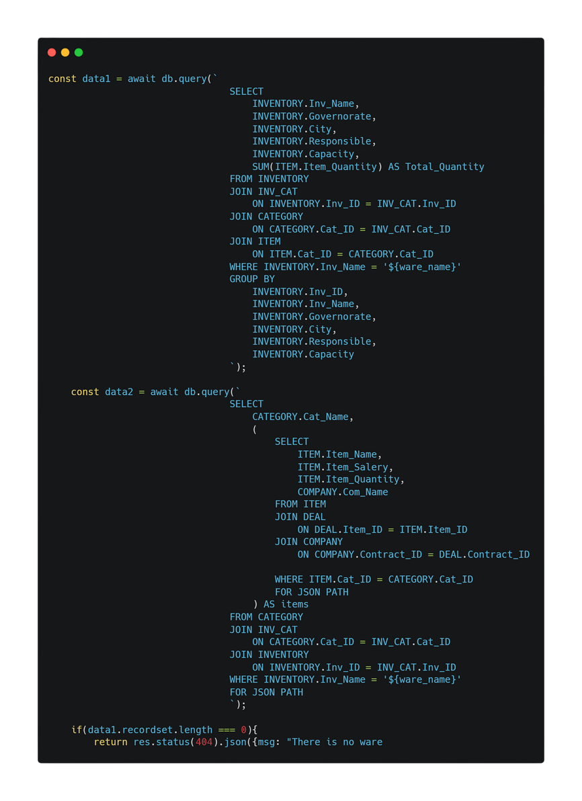
Backend
Node Js &Express
1.Warehouse Details:
Warehouse name
Governorate, city, street
Responsible person
Capacity
Total quantity of all items
Data collected through multiple JOINs
2. Categories & Items (Nested JSON)
For each category in the warehouse, the query returns:
Category name
Array of items, each containing:
Item name
Item price
Item quantity
Related company name
Built using FOR JSON PATH for clean nested output

Slide 9

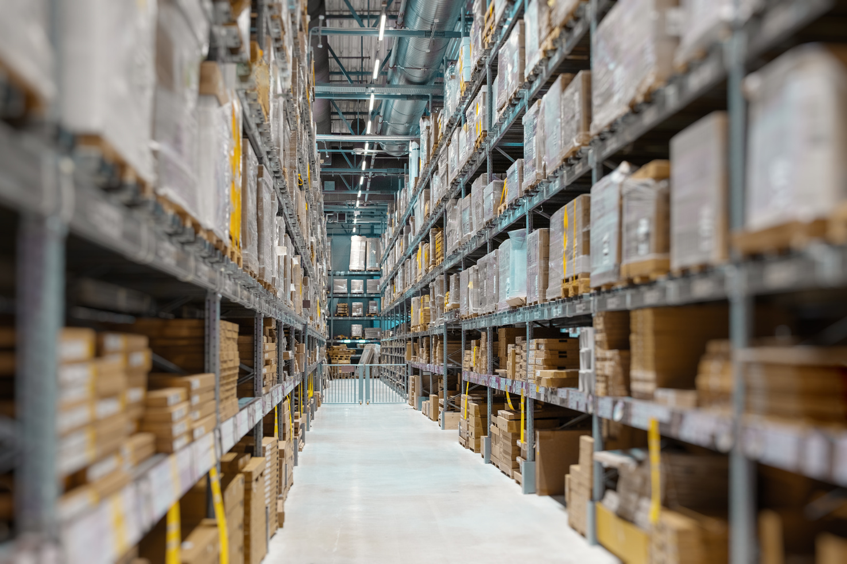

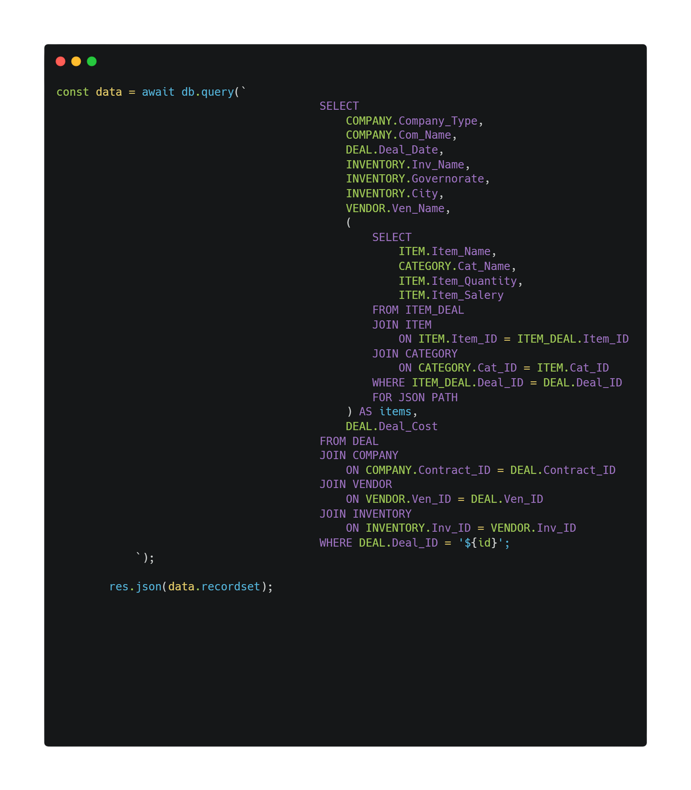
Backend
Deal Details Category
Node Js &Express
1. Deal Information
Company name & type
Deal date
Total deal cost
2. Vendor & Warehouse Data
Vendor name
Warehouse name
Governorate & city
3. Items in the Deal (JSON Nested Output)
Each item includes:
Item name
Category name
Quantity
Price
Returned using FOR JSON PATH for structured arrays
4. Outcome
Produces a complete, unified deal report from multiple tables in a single query.

Slide 10
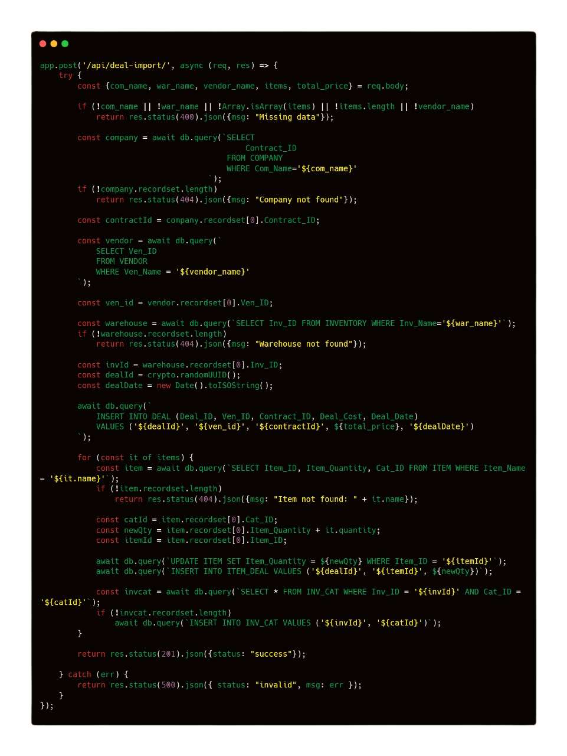

Backend
Node Js &Express

Slide 11
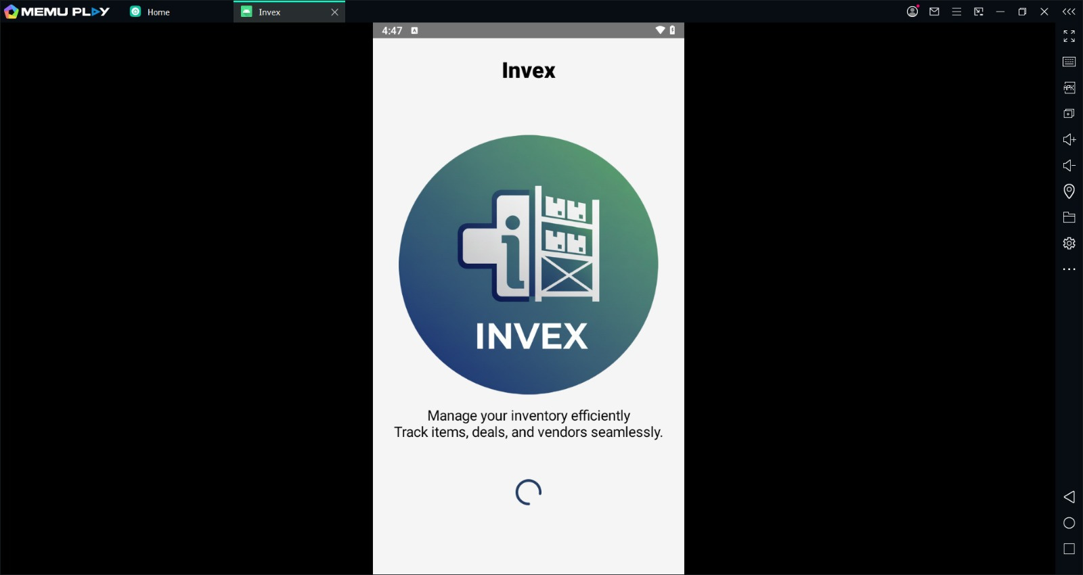


FrontEnd
BY KOTLIN

Slide 12
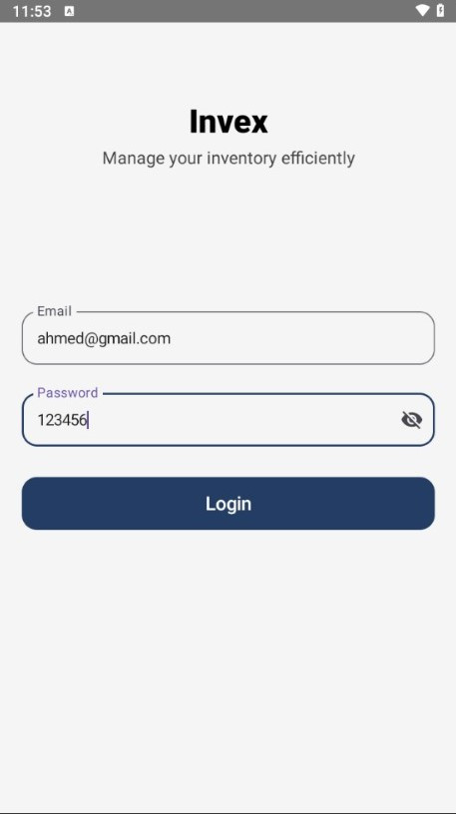
FrontEnd
Log in Screen
1. Secure Manager Authentication
Email and password login
Input validation for required fields
Password hashing with bcrypt for security
2. Database Verification
Checks manager’s credentials from the MANAGER table
Returns clear status codes:
Success
Wrong email
Incorrect password

Slide 13
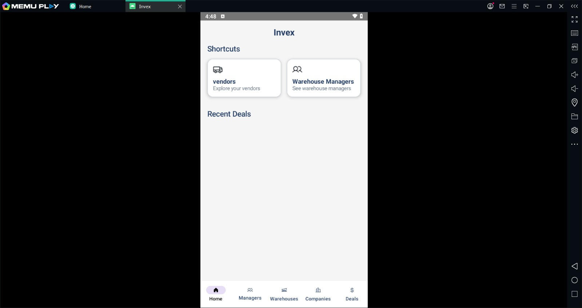

FrontEnd

Slide 14
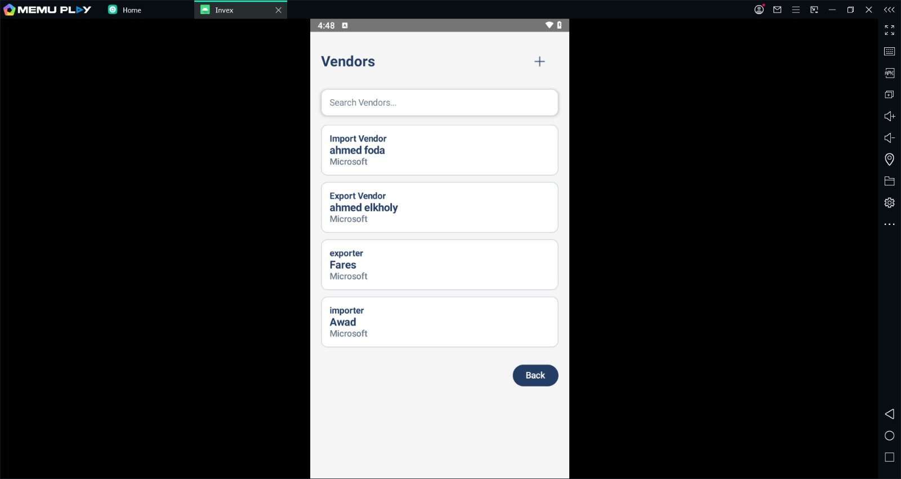


Slide 15
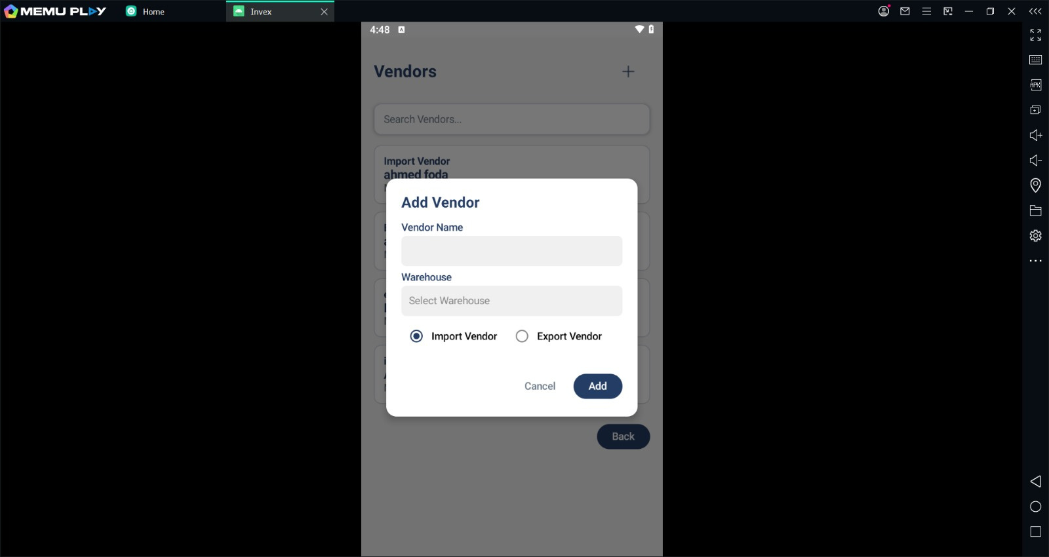


Slide 16
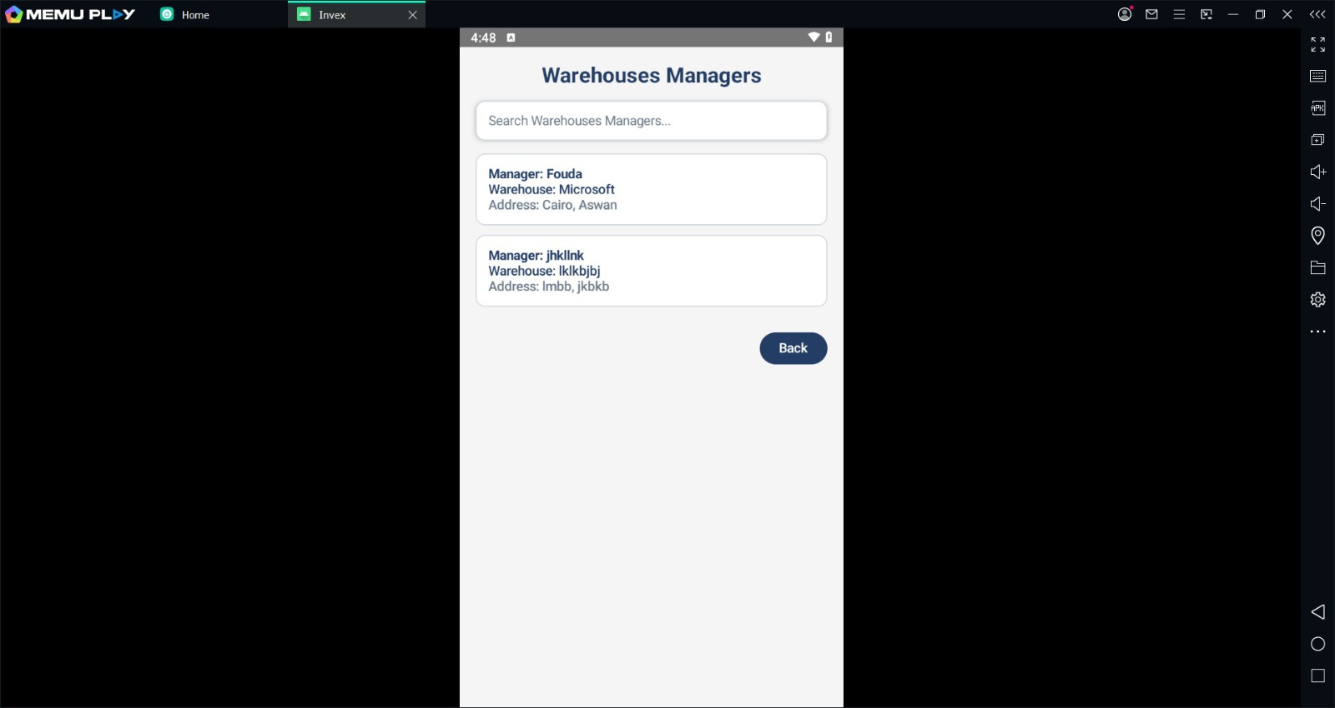


Slide 17
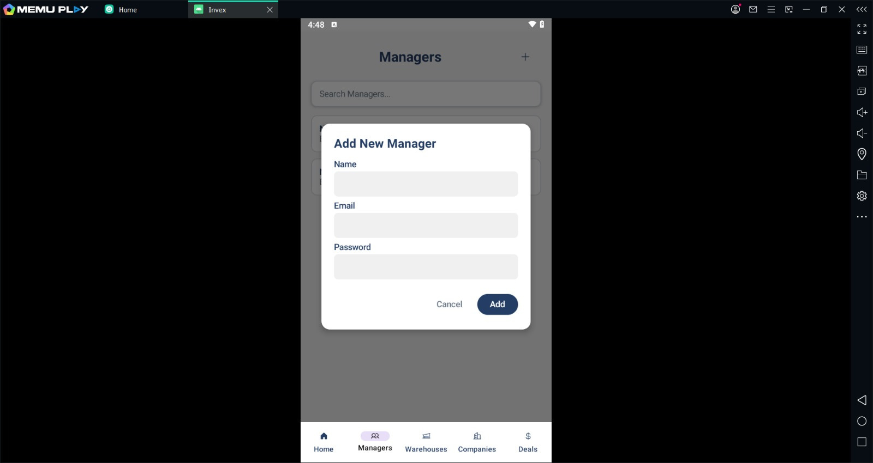

FrontEnd

Slide 18
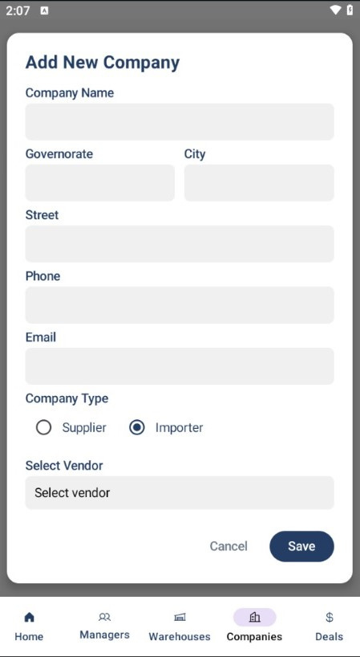
FrontEnd
Add New Company Screen
📱 Mobile Interface – Add New Company
Purpose: Streamline company registration within the app.
Key Features:
🏢 Company Details: Name, Governorate, City, Street, Phone, Email
🏷️ Type Selector: Supplier or Importer (Importer selected)
🔄 Vendor Linkage: Dropdown to associate with existing vendor
✅ Actions: "Save" to confirm, "Cancel" to discard
🧭 Navigation Bar: Quick access to Home, Managers, Warehouses, Companies (active), Deals

Slide 19
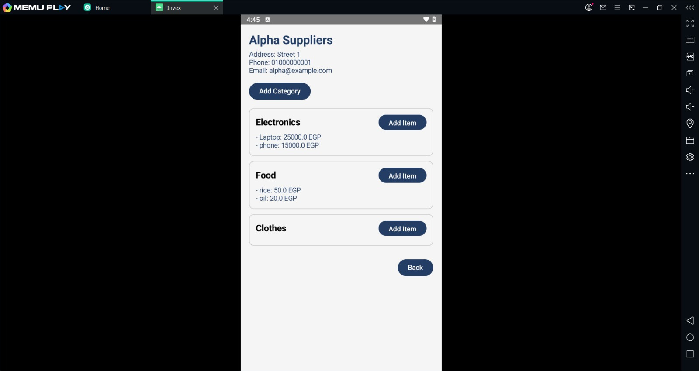

INVEX SUPPLIERS SCREEN

Slide 20

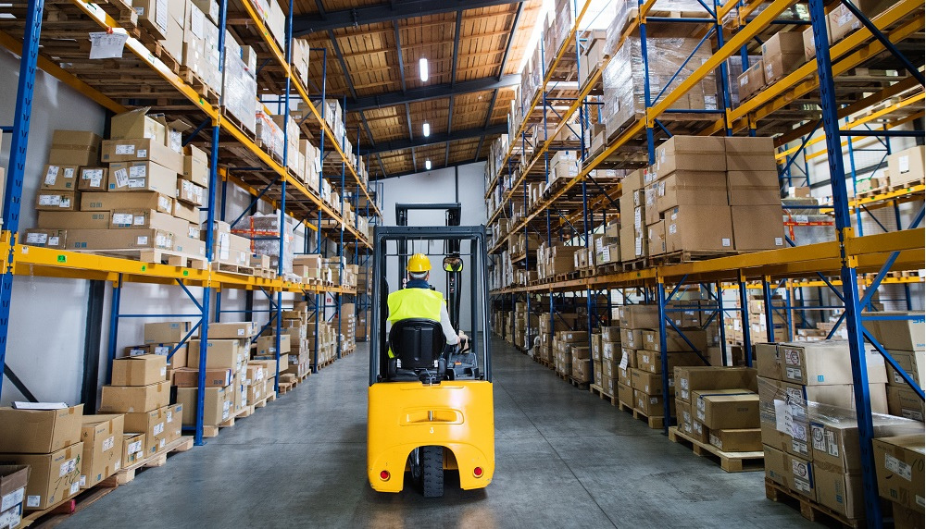
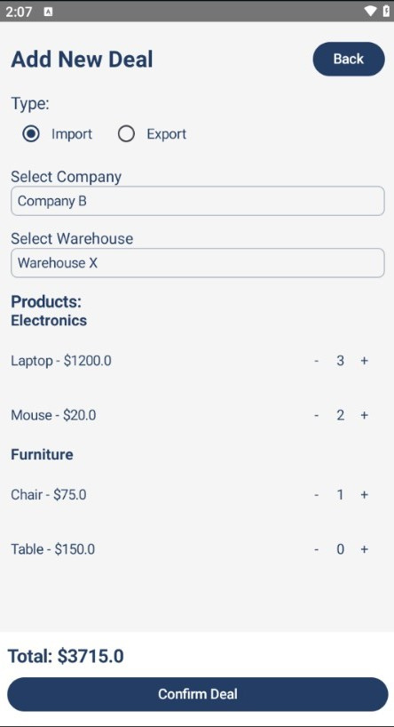
FrontEnd
Add New Deal Screen
🤝 Mobile Interface – Add New Deal
Purpose: Facilitate creation of import/export transactions with real-time product selection.
Key Features:
🔄 Deal Type: Toggle between Import and Export
🏢 Company Selection: Choose from registered companies (e.g., Company B)
🏬 Warehouse Selection: Assign deal to a specific warehouse (e.g., Warehouse X)
🛒 Product List:
Electronics: Laptop ($1200), Mouse ($20)
Furniture: Chair ($75), Table ($150)
Quantity adjustment via [+] and [−] buttons
💰 Total Cost Calculation: Auto-updated based on selected quantities
✅ Confirm Deal: Finalize transaction with a single tap

Slide 21


THANK YOU
FOR YOUR ATTENTION
TEAM
khalliha 3la allah

